Slide 1
Recipe UI
Team 7
BY: Casey Nord, Steven Phillips, Matthew Insley, Adrian Protzel, Bradley Goodlett
Notes:
Steven

Slide 2
Intro & Users
Given the ever increasing growth of the human population, the need for good UI for simple tasks like creating and accessing cooking recipes has increased. Our team’s goal was to develop a recipe site that allows for user(s) to not only obtain a specific recipe with easy usability, but also to have ways of creating and posting their own recipes.
Users:
People in need of better online recipe UI.
People looking for a specific recipe to cook.
IPFS researcher.
Notes:
Steven
Given the ever increasing growth of the human population, the need for acquiring ways to create and have access to cooking recipes has increased. Our team’s goal was the development of a Recipe site that allowed for user(s) to not only obtain a specific recipe with easy usability, but also have ways of creating and posting their very own recipe.

Slide 3
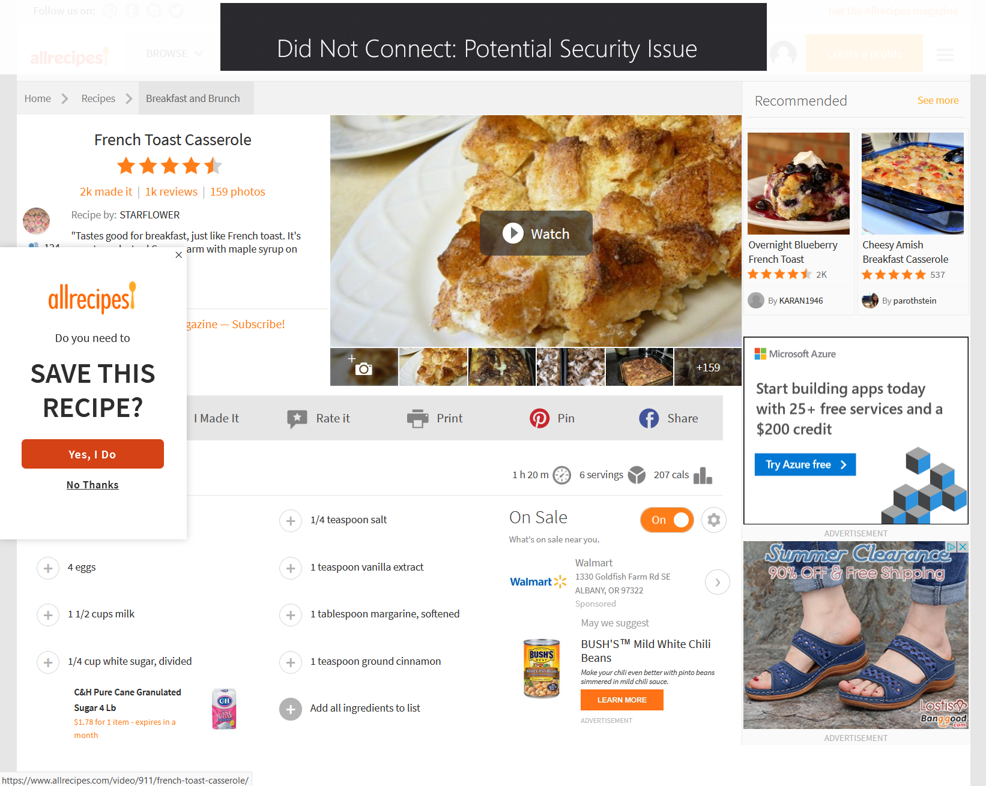
Problem
Modern recipe sites are very cluttered.
Lack of info (nutrients, allergies).
Most app data is centralized (lack of cross compatibility).
Notes:
Steven

Slide 4
Prototype Demo

Slide 5
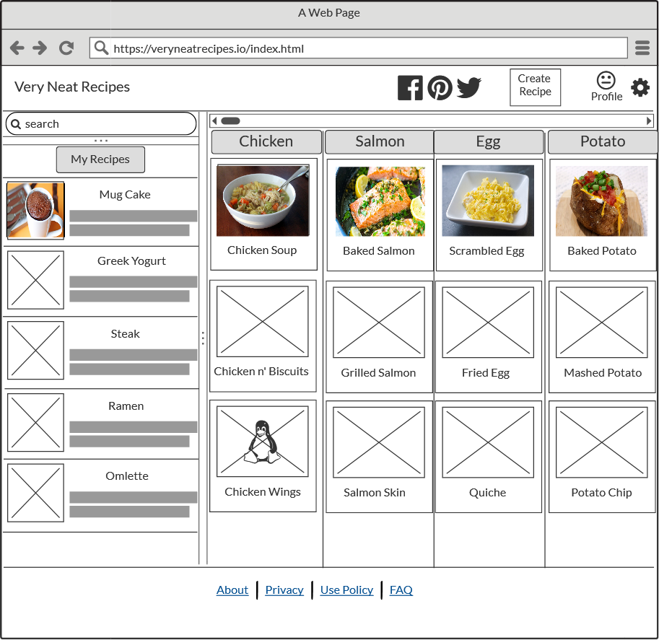
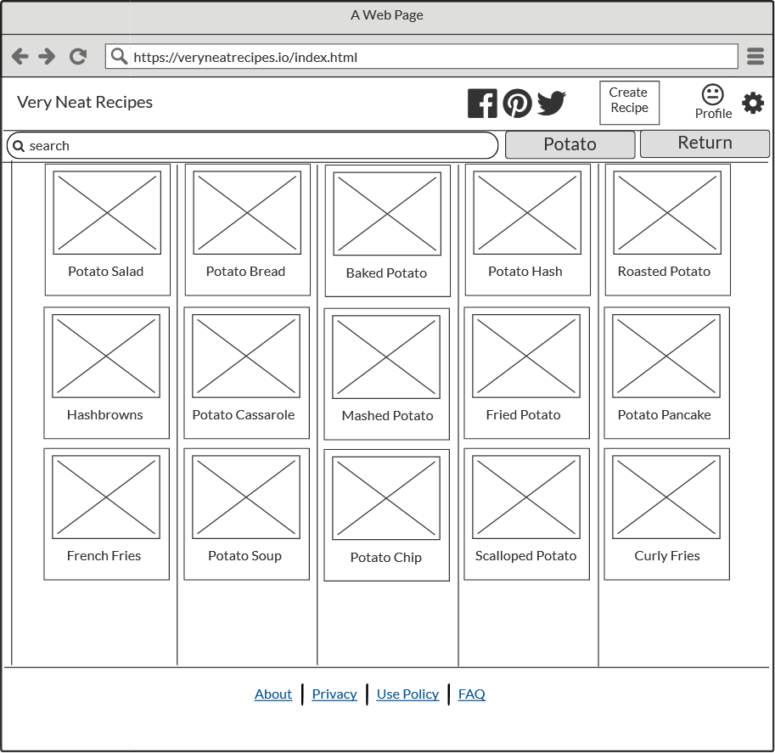
Design Principles - Visibility
All the information a user would need is displayed without needing to go to multiple pages.
Recipes are grouped into sortable categories.
Each recipe has a title with and a thumbnail photo.
Categories can be expanded and collapsed without navigating away from the main page.
Notes:
Steven

Slide 6
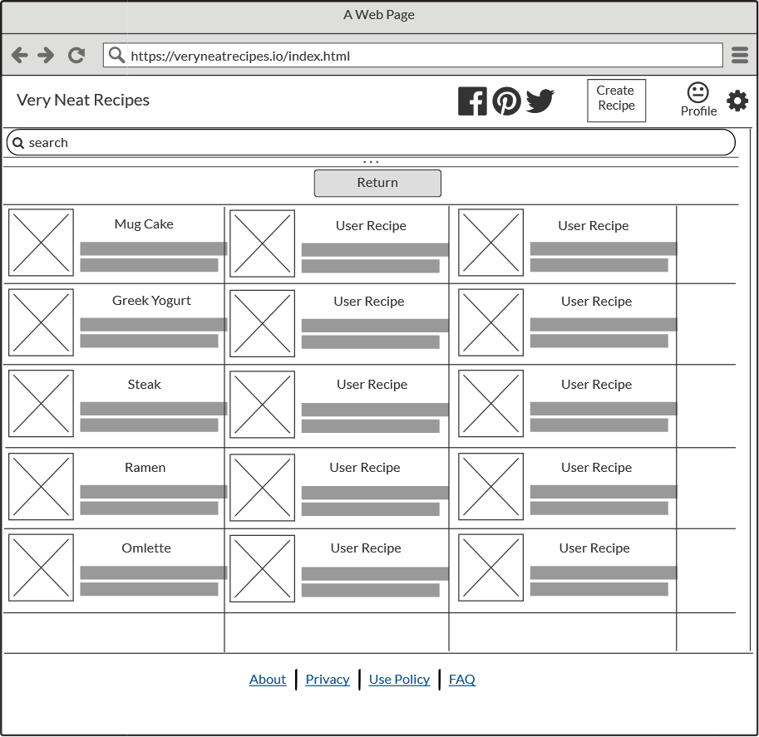
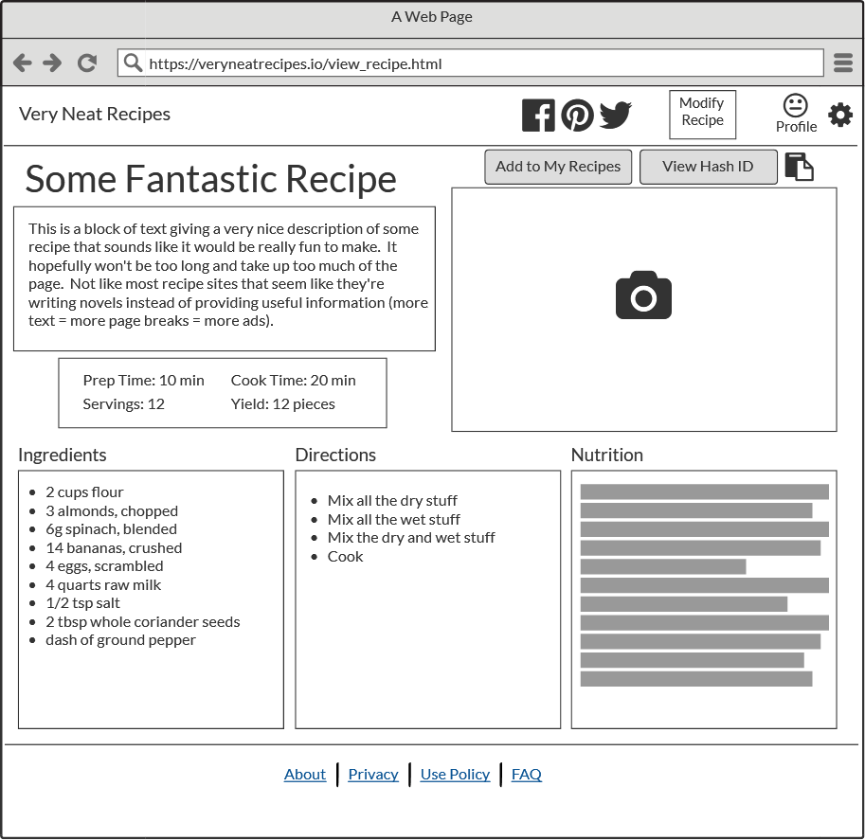
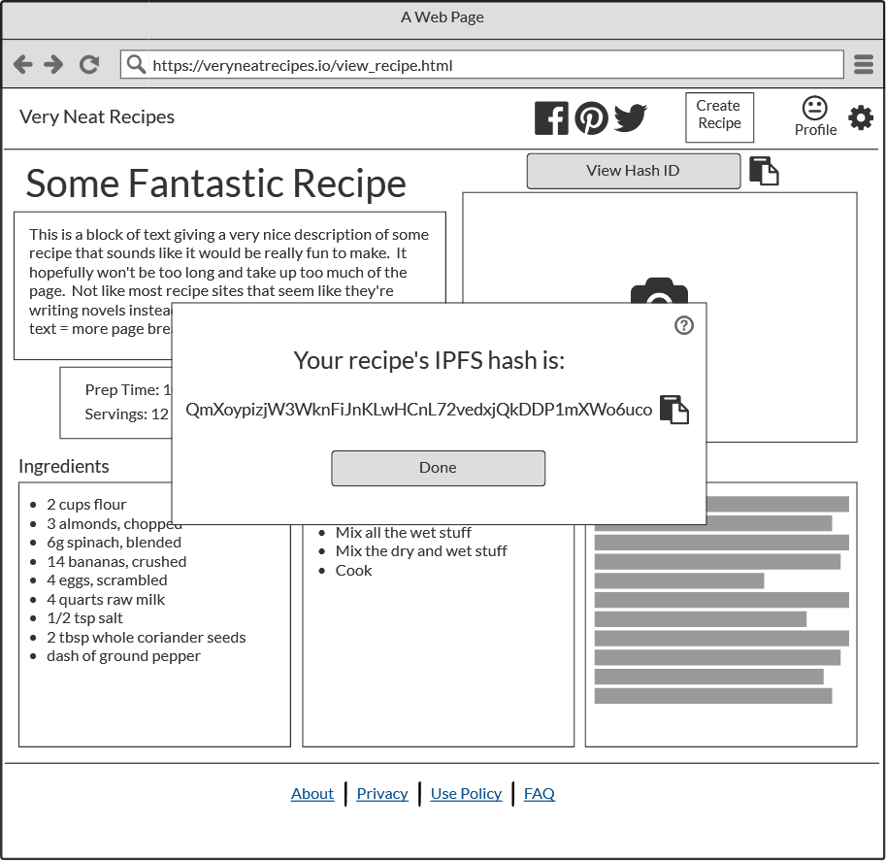
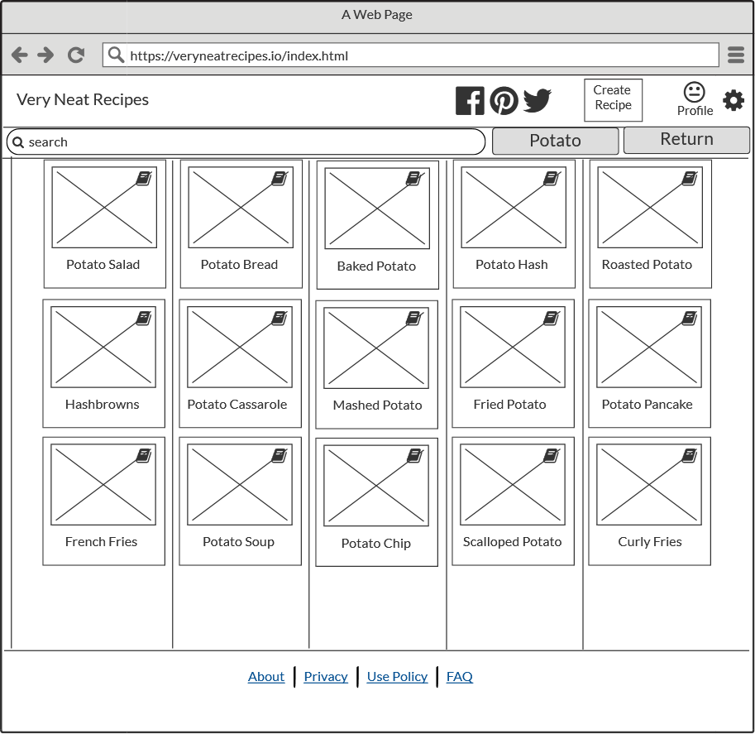
Design Principles - Affordability
Scrollbars and buttons are utilized strategically to make app functionality clear and intuitive.
Each recipe thumbnail is clickable to take the user to the recipe view page.
User recipes and searchable recipes have a different styling to make them distinct.
The app title in the header functions as a link to the home page.
Hash ID visibility can be toggled allowing advanced users to see more information.
Notes:
Matthew
This allows the user to have a clear method of clicking each recipe.

Slide 7
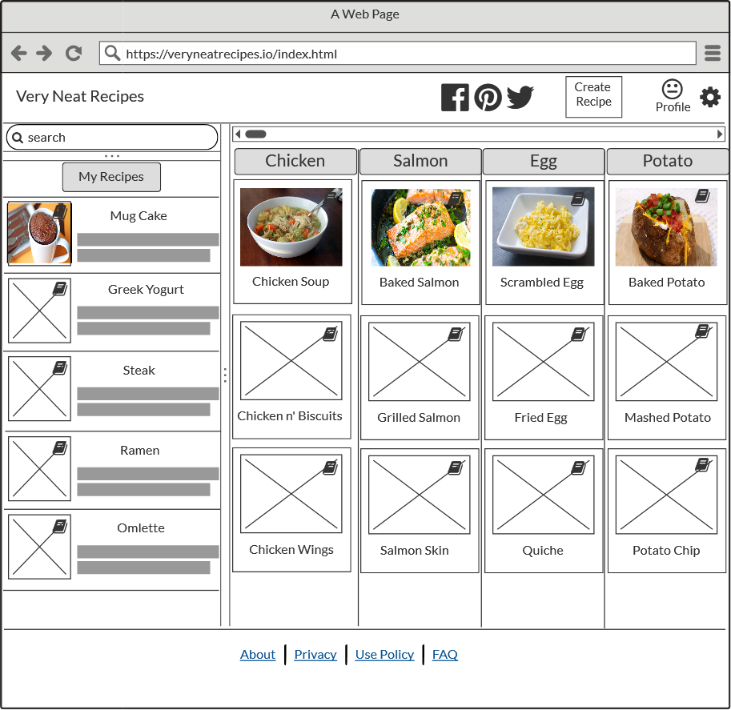
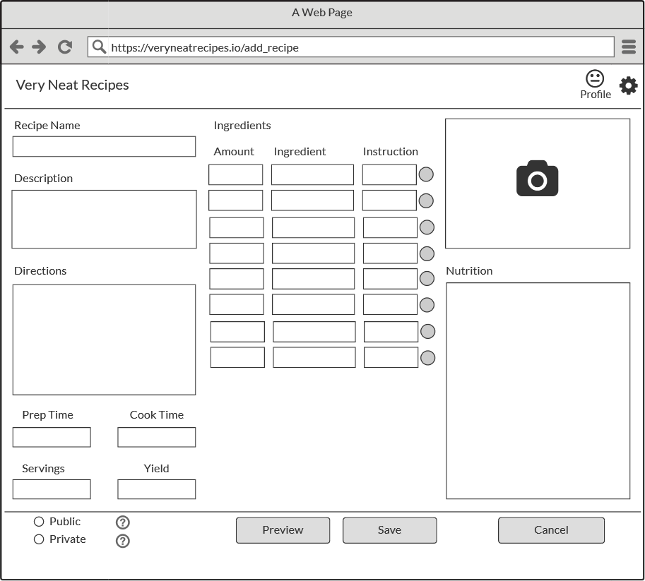
Design Principles - Consistency
Recipes are displayed similarly in a box, with a title.
User recipes and home page buttons are always in the same place.
Navbar and footer are consistent across all pages only changing where necessary.
Each recipe has a minimum requirement of a title, image, process, and ingredients.
Notes:
Matthew
Internal consistency, not external

Slide 8
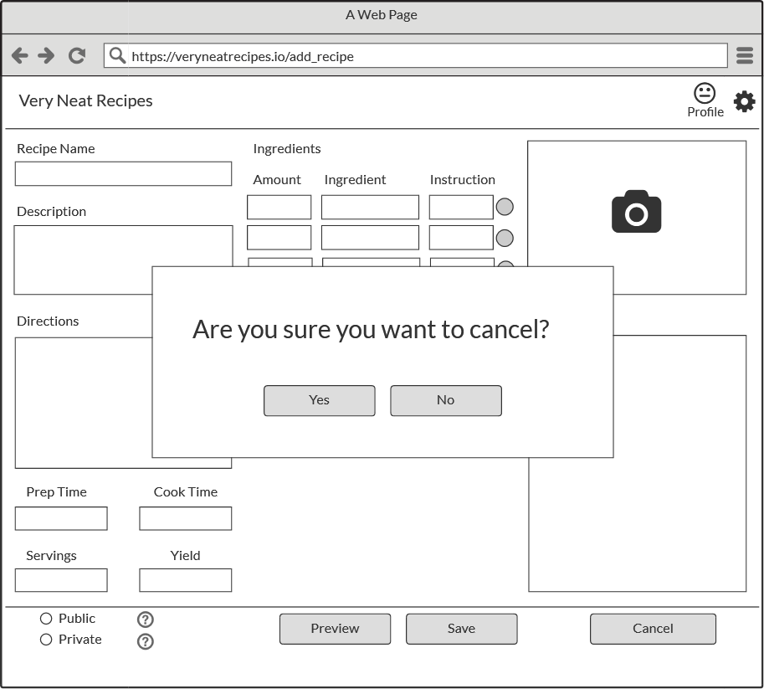
Design Principles - Feedback
Expanding/collapsing pages can be animated to provide a better visual experience.
Prompts are displayed for events such as adding and cancelling recipes.
IPFS hashes are displayed if enabled for advanced users.
Mouseover tooltips and and hover based interaction will give better interactivity.
Notes:
Matthew

Slide 9
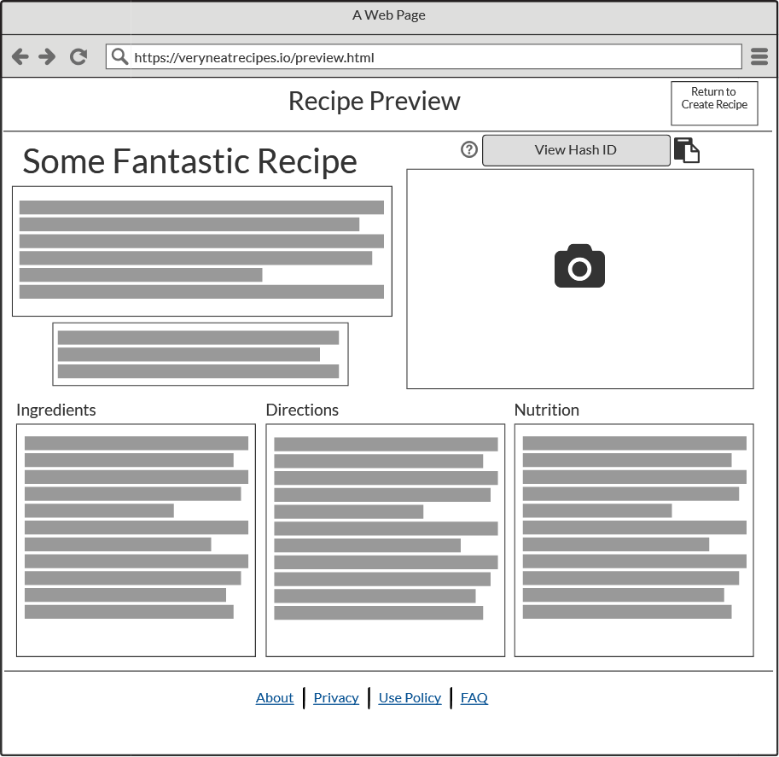
Design Principles - Constraints
Each recipe has a minimum requirements before posting
The create recipes page uses forms to help enforce proper formatting and data structures.
Hash display is initially turned off in profile settings.
Notes:
Brad Goodlett
There is a minimum data requirement before a user is allowed to post a recipe. All of the statically sized fields such as recipe name, description, etc. are required to be filled out before a user can submit the recipe. This ensures that only complete recipes can be uploaded to the site for viewing. The ingredients field is a bit different because it is a list of fields that can be expanded, so for them we would just check that there is at least one filled out because you can’t have a recipe with 0 ingredients.
No user sign up or log in page right now, but these would also include constraints such as requiring a username and password
Create recipe page forces users to enter their data in a specific format. This ensures that the recipes on the site are always in the same.
Hash display is disabled by default to avoid confusion

Slide 10
Feedback from prior Feedback
Filters will be included for fine tuning searches. This will include categories like author, rating, diet restriction, etc.
Buttons and other UI elements have been made consistent across all pages.
IPFS functionality is opt-in so as not to confuse less technologically experienced users.
Removed redundant “My Favs” options and pages to improve overall usability.
Notes:
Brad Goodlett
During the design review it was recommended that we add the ability to filter search results. In an actual implementation of this we would intend to include filtering features to searching.
Our implementation of the search filtering would include filtering by author, rating, diet restriction (ex, no peanuts), etc.
The IPFS functionality (view hash on recipe page, hashes on thumbnails) was confusing people because they were not sure what it meant. To fix this confusion without removing the functionality, we created a toggle for displaying hash information and set it to off by default. This would allow the website to reach a wider audience while allowing more advanced users to access the underlying technology of the website.

Slide 11
Design Justification: Heuristic Evaluation (Nielsen’s)
A standardized footer has been added to relevant pages to provide better navigation and memory-recognition.
A FAQ page has been added to help teach users about advanced functions to provide documentation.
Help buttons have been included throughout to provide more focused assistance. This helps to create more focused documentation and enhances memory-recognition and efficiency.
Links to hash identifiers have been added directly on thumbnails. This prevents them from being nested in only one location.
A final product could include custom error pages to provide better error handling.
Notes:
AJ

Slide 12
Design Justification: User Evaluation
Users reported that they preferred having the recipe view page limited to a single screen. Feedback reported easier readability & less having to interact with page while preparing recipes with dirty hands.
Users found our UI easy to navigate and found multiple ways to complete a single task.
Hash IDs were confusing for some users, so has been made toggleable and disabled by default.
A final product could include an alternate create recipe form, as well as different recipe views.
Notes:
AJ

Slide 13
Thank you for Listening!

